Slide 1
RETAIL MANAGEMENT SYSTEM
Student Name: | Arjun Doshi | Ananya Giliyal | Aashna Shah | Aryan Shah
Roll No: | J053 | J003 | J042 | J047
Faculty Mentor: Prof. Krishna Samdani

Slide 2
Outline
Motivation
Introduction
Tools & Techniques
Simulation & Results
Conclusion
Future Work
Reference
30 April 2020
Computer Engineering Dept. MPSTME, Mumbai Campus

Slide 3
Motivation
One often faces issues in the billing process and is not satisfied with the efficiency of the billing system.
We decided to build an integrated system where billing is efficient in terms of searching for store products, viewing stock levels and print receipts
Our software is easily accessible and can be used by small businesses too. By empowering these small businesses that stimulate economic growth, we could contribute to the welfare of humanity.
30 April 2020
Computer Engineering Dept. MPSTME, Mumbai Campus

Slide 4
Introduction
Our project is an easy-to-learn and hassle-free software interface.
It includes the following features:
Admin and Customer Login
Importing items
Tracking Inventory
Inventory counts
Print receipts
Tax invoice
Inventory history
Discount Reward Program
Customer base
30 April 2020
Computer Engineering Dept. MPSTME, Mumbai Campus

Slide 5
Tools & Techniques
We have used Visual Studio Code (VSC) as our primary IDE.
VSC is a user-friendly and cross-platform which includes various extensions and works on multiple platforms.
The devices used for writing and executing this code are HP spectre X360 (RAM 16GB) and MacBook Air 2020 (RAM 8 GB).
30 April 2020
Computer Engineering Dept. MPSTME, Mumbai Campus

Slide 6
Simulation & Results
What problems did we choose to confront?
The lack of a singular local system is a difficulty faced by most retailers. The integration of a user and admin system would allow ease of operations. We decided to create a simple but effective program to tackle this issue..
30 April 2020
Computer Engineering Dept. MPSTME, Mumbai Campus

Slide 7
Solution Design
a. Global editable database of products
b. User friendly billing system:
c. Billing History Database & Encrypted Customer Database
d. Providing Menu based interface for easy access

Slide 8
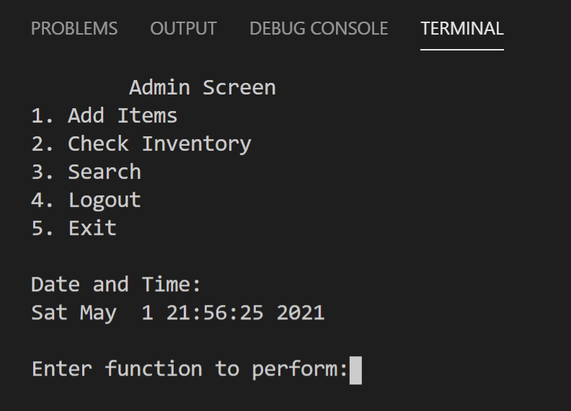
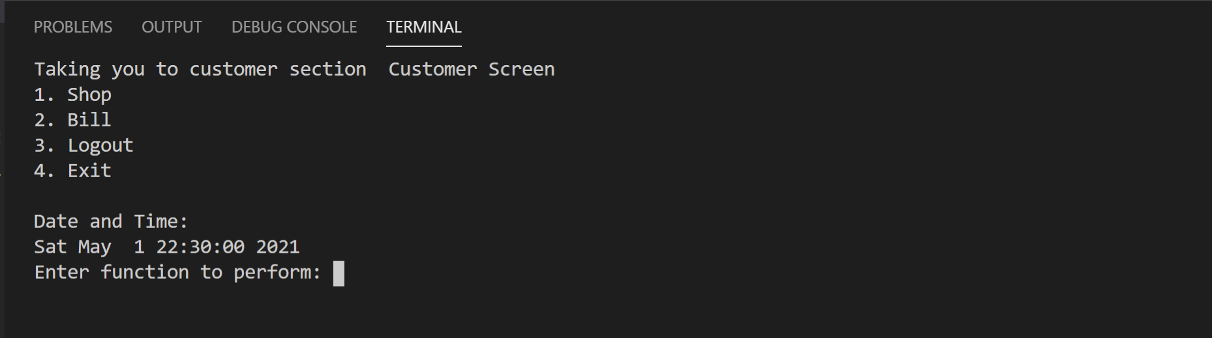
II. Simulation-Navigation
Admin Back-office
B. Customer Login

Slide 9
Conclusion
With our program, you can manage inventory & sale with ease.
Irrespective of whether you have a single store or multiple ones, you can use our tool to run your business.
If this code is enhanced, it could be an alternate format for the modern-day billing and online retail system.
Hence, our tool could help people around the world to manage their sales, inventories, employees and customers.
30 April 2020
Computer Engineering Dept. MPSTME, Mumbai Campus

Slide 10
Future Work
The system is local and offline but, it could be an online web application.
The system informs the admin user of low stock levels before hand.
Upgradation of the software could find the most profitable company to buy the stock when the stock levels are low.
This upgrade would positively affect the sales, ensuring that the system would not be out of stock.
Stock input from multiple .csv files
30 April 2020
Computer Engineering Dept. MPSTME, Mumbai Campus

Slide 11
References
Java point : https://www.javatpoint.com/file-handling-in-c [28/04/21]
GeeksforGeeks : https://www.geeksforgeeks.org/relational-database-from-csv-files-in-c/ [24/04/21]
Stack overflow: https://stackoverflow.com/questions/5141960/get-the-current-time-in-c [21/04/21]
30 April 2020
Computer Engineering Dept. MPSTME, Mumbai Campus

Slide 12
THANK YOU !

